Slide 1


SETHU INSTITUTE OF TECHNOLOGY
Department of
COMPUTER SCIENCE AND BUSINESS SYSTEMS
19UCB801 – FINAL YEAR PROJECT
E – BOT
An Advanced Chatbot built using NLP and Keras Neural Networking
Mr. V. Rajesh Kumar B.E, M.E,
Assistant Professor
Department of CSBS
Aravind S – 2020113002
Aravinth S – 2020113003
Palaniappan M – 2020113306
Notes:
Color code:
60 – 6B90B2
30 – 1B558E
10 – CCD64D

Slide 2
Abstract
E – Bot is web based chatbot application that aims to simplify the user access to Tamilnadu E-Service websites by seamlessly guiding them through various processes. E – Bot uses Natural language processing (NLP) and Keras neural network algorithms to comprehend and respond human like answers. The proposed system not only allows users to fetch details and make payments but also adapts to their prompt and recording valuable data for the future training.

Slide 3
Literature Review – 1
Journal Name | Journal of System and Management Science Vol:13 [2023]
Title | Improving Chatbot Performance using Hybrid Deep Learning Approach.
Authors | Palanisami Naveen¹, Sue-Cheng Haw², Devakumar Nadathan³
Methodology Used | Data gathering and data Pre-Processing is the initial step of the this theoretical model. The next crucial step is building hybrid model which generates real time text using pre defined model and the output is refined using encoder.
Limitations | Restricted Capabilities and Loss of Generic Inputs.
Source - https://www.aasmr.org/jsms/Vol13/No.3/Vol.13.3.34.pdf

Slide 4
Literature Review – 2
Journal Name | Science Direct vol:11, Edition: 100198 [2023]
Title | A comparative study of retrieval – based and generative – based chat bot using Deep Learning and Machine Learning.
Authors | Sumit Pandey¹, Srishti Sharma²
Methodology Used | Data gathering and data Pre-Processing using quasi-statistical method to analyse the importance of school based mental health service (SBMHSs). It is a multi-tiered approach which trains the processed data to generate an accurate response.
Limitations | Limited responses, Once started, the training model cannot be modified.
Source - https://www.sciencedirect.com/science/article/pii/S2772442523000655

Slide 5
Literature Review – 3
Journal Name | Journal of Management and Services Science Vol.: 02, Article: 15 [2022]
Title | Artificial Intelligence based Chat bot: A Case Study.
Authors | Nidhi Singh Kushwaha¹, Pawan Singh²
Methodology Used | It is a Rule-based chat bot guided with pre defined questions and it’s respective answers. It uses NLP engine to communicate with user which has internet classifier and entity extractor.
Limitations | It does not shift from thing it already knows.
Source - https://jmss.a2zjournals.com/index.php/mss/article/view/15/15

Slide 6
Literature Review – 4
Journal Name | IEEE – Springer Vol.: 11-18 Article: ICTCS 15 [2022]
Title | AI-Based Interactive Agent for Health Care Using NLP and Deep Learning.
Authors | Hemavathi U¹, Ann C. V. Medona²
Methodology Used | AI based interactive agent using Natural language processing and Deep learning which deals with simple queries and provide health cares services. It uses NLP and neural network to process data.
Limitations | Requires intense training of pre-processed data.
Source - https://link.springer.com/chapter/10.1007/978-981-19-0095-2_2

Slide 7
Literature Review – 5
Journal Name | IEEE – Springer Vol.: 398 2nd Edition [2021]
Title | Music Genre Classification Chat Bot.
Authors | Rishit Jain¹, Ritik Sharma², Preeti Nagrath³ and Rachan Jain⁴
Methodology Used | It is a music information retrieval (MIR) the uses traction of Convolutional neural networking (CNN) to differentiate between audio files by assessing the visual representation of the timbral features.
Limitations | Cannot be trained with pre-processed data. Training for each and individual user is important.
Source - https://link.springer.com/chapter/10.1007/978-981-16-0733-2_27

Slide 8

Problem Statement
There are 6,868 plus websites provided by our government.
But, only less than half of the websites are being used.
One of the main reason for that it is hard to navigate and identify the genuine webpage.
Total websites : 6,868 (approx.)
Used websites : 2,998
Unused websites : 3,870+

Slide 9
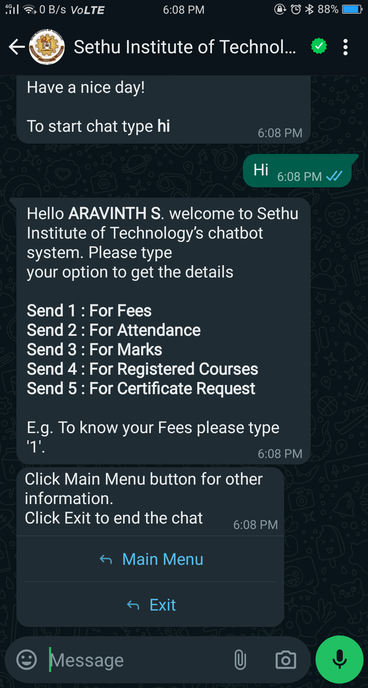
Existing System
Menu based Chatbot
A Menu based chatbot generates replies using simple heuristics rule-based system to answers queries. It has only limited personalization.
Rule-based Chatbot
A rule-based chatbot generates replies using decision tree. It uses simple if – else condition to satisfy the users queries.
Rule-Based Chatbot
Menu-Based Chatbot

Slide 10
Drawbacks in Existing System
There is no prior feature to navigate users through E-Service website.
Manual navigation using human knowledge.
Absence of feedback system to know about users experience.
Unavailability of live training and pre-processing model web based chat bot.

Slide 11
Proposed System
Proposed solution is a conventional chatbot.
This helps users to answer their queries and navigate through the E-Service government website.
Users will be directed straight to the webpage they seek.
This chatbot has features like,
Common Queries
Bill Payment
Document Download
Toll – Free Numbers

Slide 12
Advantages of Proposed System
Secured chat history storage that does not involve personal information.
Allows user to pay bills using local storage and secure payment gateway.
Uses real time data of user to produce adaptive responsive answers according to the users.
Stored chat history of user can be used in future to train the model.

Slide 13
Block Diagram
User Interface
ALGORIMTHS
Sorting Algorithm
Merge Sort Algorithm
Database
API
Searching Algorithm
Binary Search Algorithm
Server
Neural Networks
Developer
NLTK & KERAS

Slide 14
Module Design
Module - 1
Data gathering
Pre-Processing
Module - 2
Data training
Model generation
API Integration
Password management
Module - 3
Module – 4
UI / UX development
Deployment

Slide 15
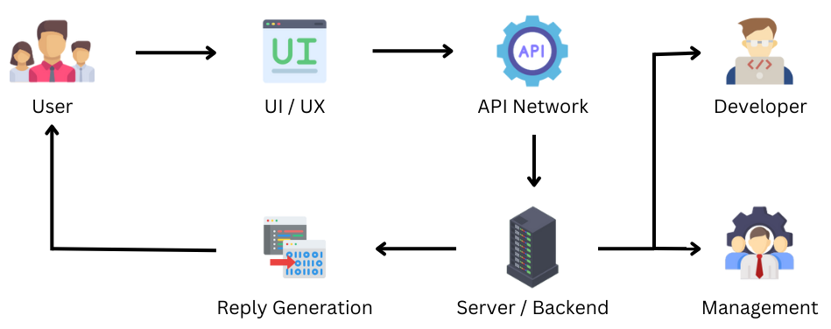
Data Flow Diagram

Slide 16

Module 1 – Data Gathering
Collecting website details.
Categorizing the websites.
Users need and Requirements.
Website usage statistics according to time and region.

Slide 17

Module 2 – Training Data
Pre-processing the gathered data.
Organizing the pre-processed data.
Using Algorithms to train the data.
Creation of training model using processed data.
Processing data using NLP and Keras algorithms.

Slide 18
Module 3 – API Integration
Integration of third party API’s
IP- Geo Location : To track users location (Only if required).
Password Safe : To store users personal data in their local storage.
Razor pay Gateway : Payment gateway to pay bills.

Slide 19

Module 4 – UI / UX Development
Development of user interface.
Integration of front-end and back-end.
Application testing with various scenarios.
Deployment of the application

Slide 20
Algorithms and Methodology
Natural Language Processing : Can understand and reply human like answers.
Tensor Flow : Used along with NLP to train the pre-processed dataset and create a base model to work with.
KERAS : Keras is neural networking algorithm which defines relationship between multiple question.
NumPy : Mathematical algorithm used to ID the datasets.

Slide 21
Data Sets
JSON file is used to store the data set.
Total Dataset used – 03
Current Data set count – 217 possibilities
Data Type | Data set
Pre – Defined | Universal Dataset
 | Intent Recognition
User - Defined | Custom Dataset
{"intents": [
{"tag": "greeting",
"patterns": ["Hi there", "How are you”, “Hello”],
"responses": ["Good to see you!", "Hi there, how can I help?"]
}
}
Source - https://github.com/Aravinth-S-731/E-Bot/blob/main/data.json

Slide 22












Implementation
FRONT-END DEV
BACK-END DEV
DATASET
FRAMEWORK
API’s
HTML
IP Geolocation
HTML
Python
Kaggle
Flask
CSS
ALGORITHMS
Password Safe
NumPY
NLTK
TensorFlow
JavaScript
Razor Pay API

Slide 23
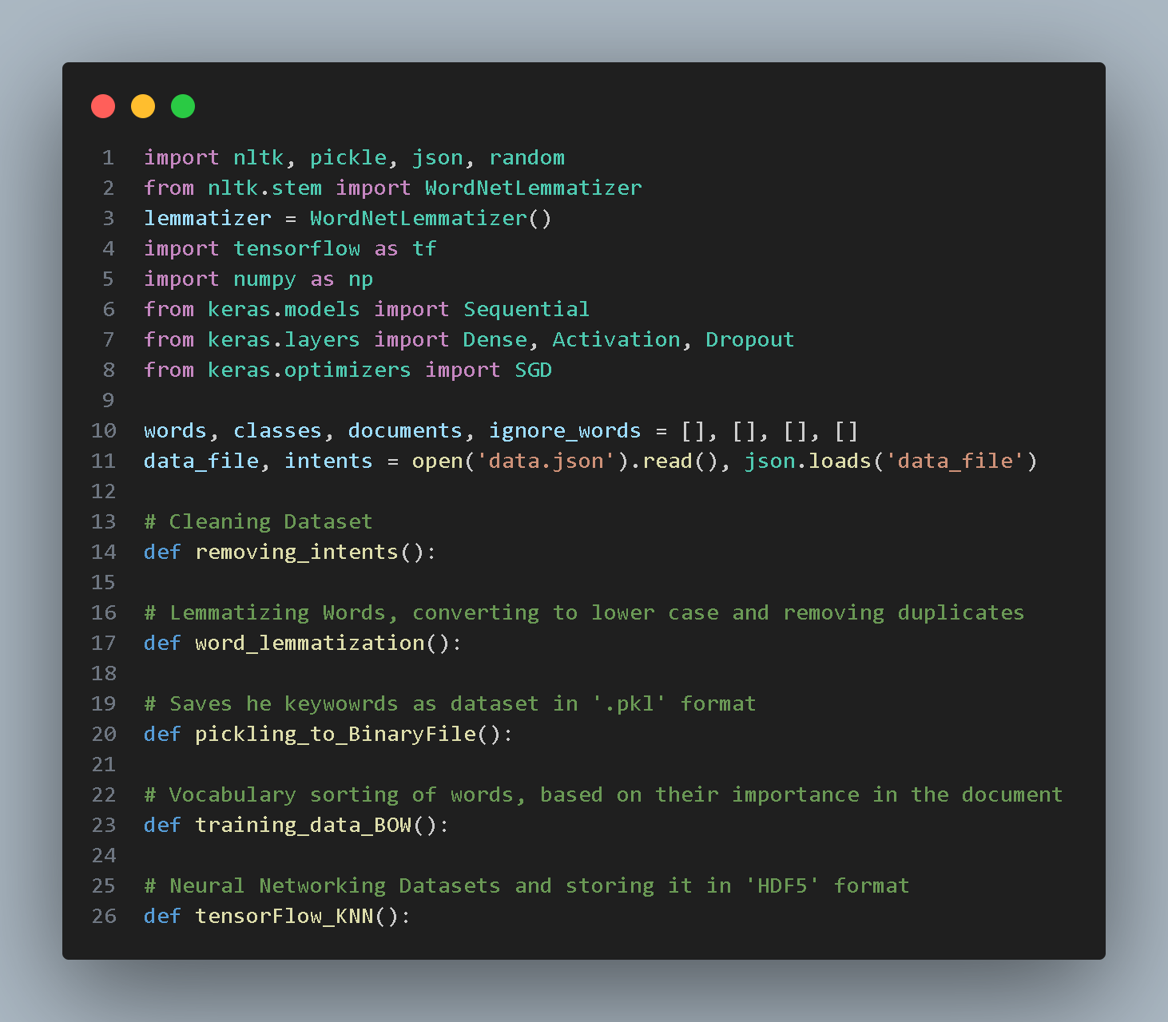
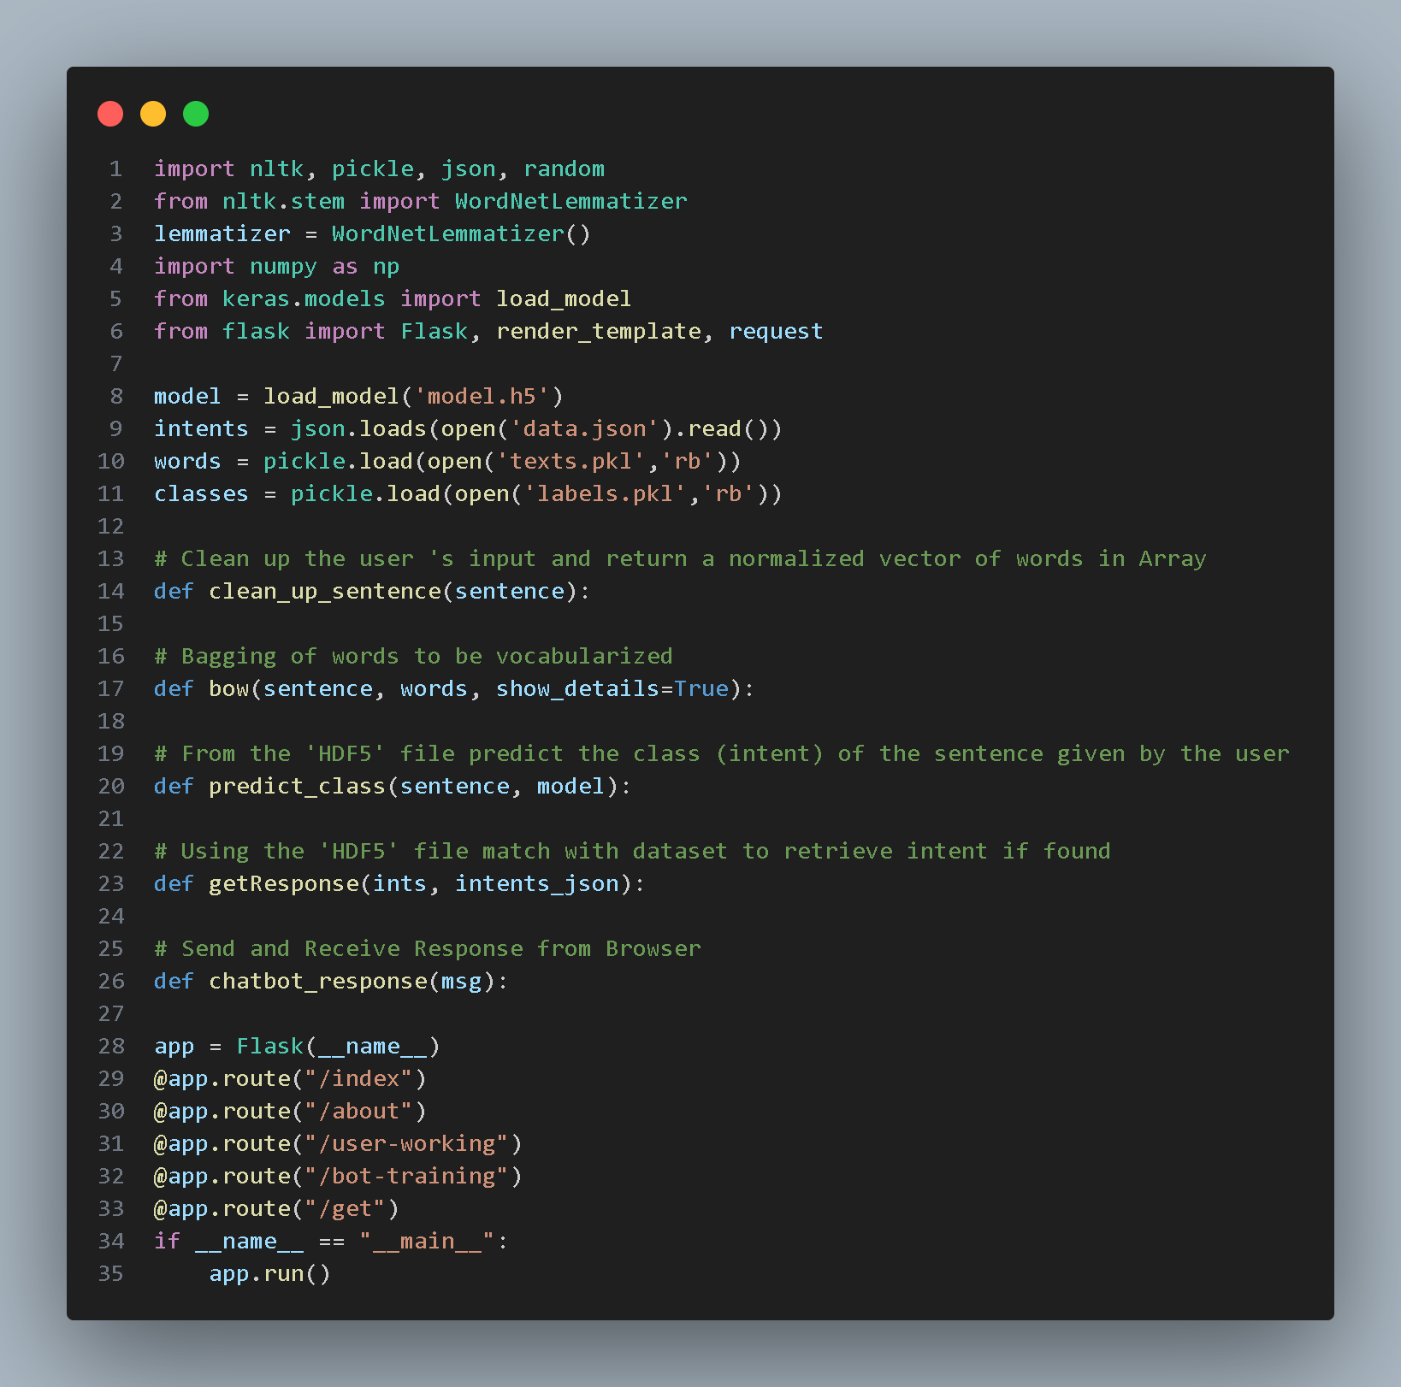
Sample Code
Training Dataset
Server Application

Slide 24
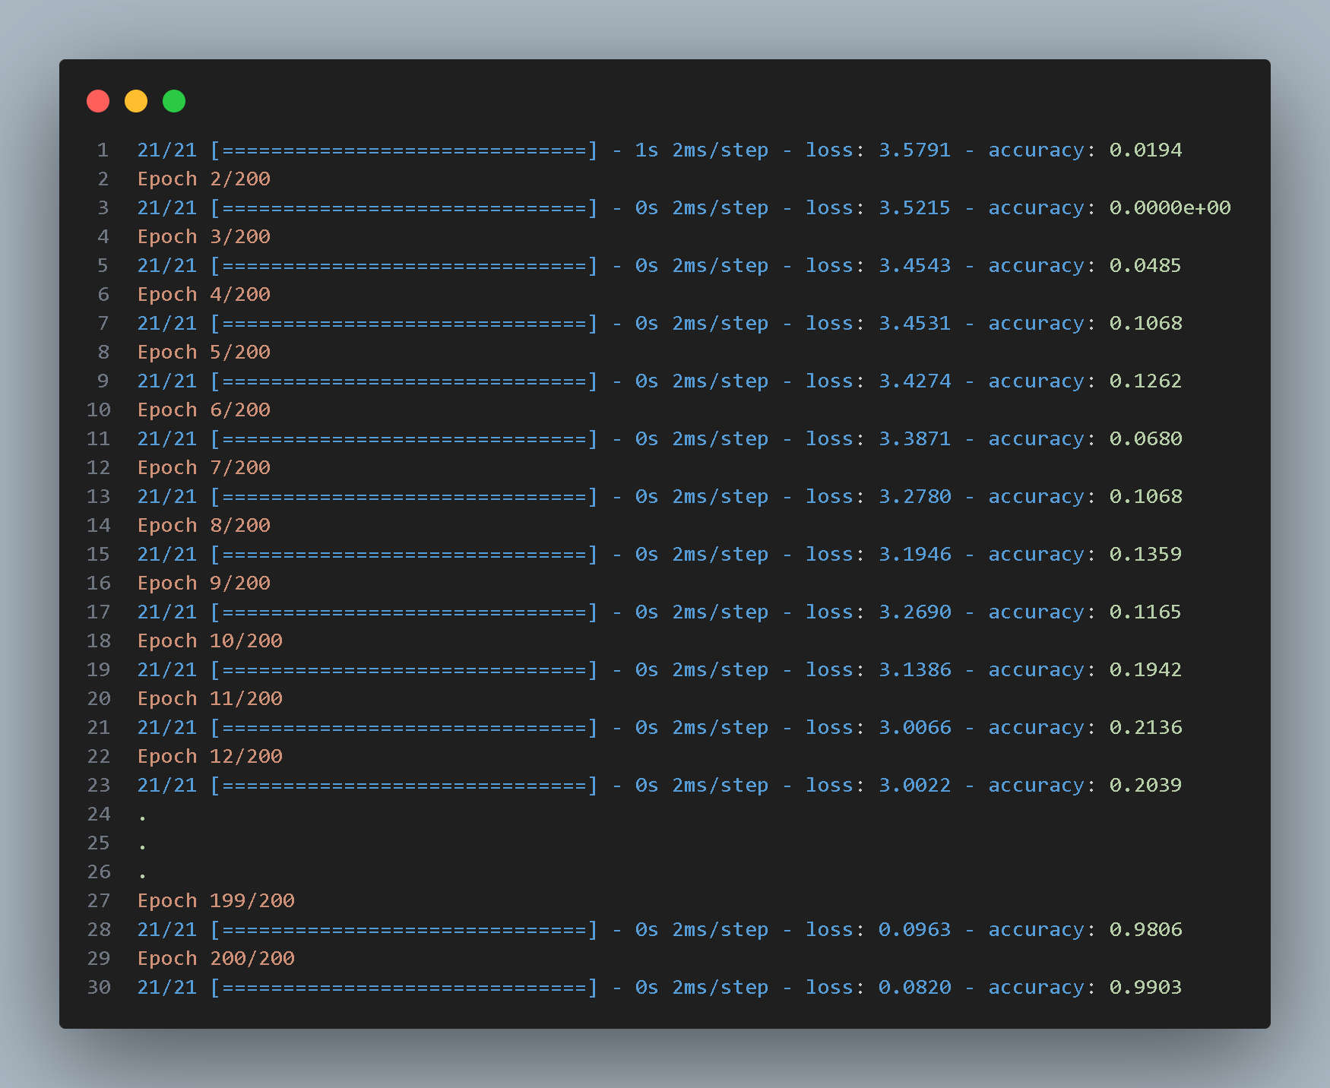
Performance Metrics
Accuracy: 0.9709 = ~ 97%
Loss: 0.0890 = ~ 8%
Precision: 85%
Interference Time: 0.02 Sec
Training Time: 144 mins (~2.15 hrs.)
Memory Used: 6 GB ( ± 400 MB )

Slide 25
Comparison with Existing Solution
Characteristics | Existing Solution | Proposed Solution
Logic | Decision Tree | Natural Language (NLP)
User Interaction | Menu / Buttons | Queries / User Input
Interaction Flow | Corresponding to Inquiry | Context-Aware Response
Personalization | NA | As Required
Use Case | FAQ’s / Pre-defined | Dynamic Conversation
Advantages | Lower Development Cost | Scalable

Slide 26
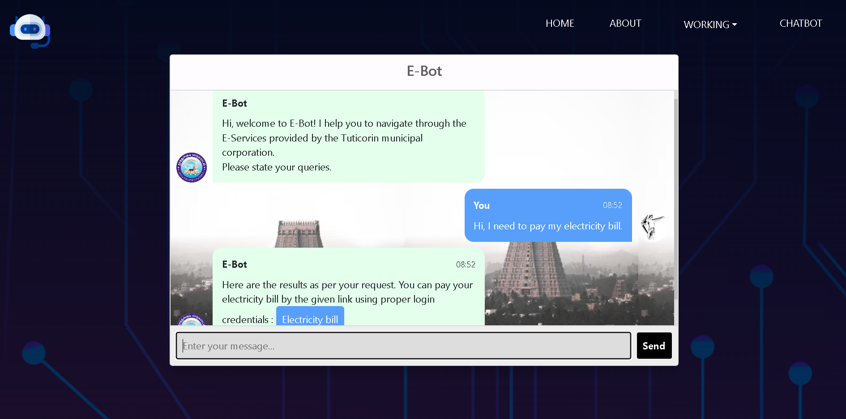
Result / Output

Slide 27
Scope for Improvement
Expanding Dataset modules.
Training data with real-time queries.
Payment gateway to avoid Third party applications.
Enable application to function offline.
Using Big-data tools to reduce processing time.

Slide 28
References
Improving Chatbot Performance using Hybrid Deep Learning Approach. Palanisami Naveen¹, Sue-Cheng Haw², Devakumar Nadathan³ - https://www.aasmr.org/jsms/Vol13/No.3/Vol.13.3.34.pdf
A comparative study of retrieval – based and generative – based chat bot using Deep Learning. Sumit Pandey¹, Srishti Sharma² - https://www.sciencedirect.com/science/article/pii/S2772442523000655
Artificial Intelligence based Chat bot: A Case Study. Nidhi Singh Kushwaha¹, Pawan Singh² - https://jmss.a2zjournals.com/index.php/mss/article/view/15/15
AI-Based Interactive Agent for Health Care Using NLP and Deep Learning. Hemavathi U¹, Ann C. V. Medona² - https://link.springer.com/chapter/10.1007/978-981-19-0095-2_2

Slide 29
THANK YOU
Mr. V. Rajesh Kumar B.E, M.E,
Assistant Professor
Department of CSBS
Aravind S – 2020113002
Aravinth S – 2020113003
Palaniappan M – 2020113306

